Slide 1
ANTI-BULLYING WEEK
13th – 17th November 2023
2023 Theme:
Ground Rules…
Listen to all opinions!
Agree to stay respectful!
Only one person to talk at once!
No personal comments
Don’t name anyone!
See me if you are worried about bullying
Notes:
INSTRUCTIONS:

Slide 2
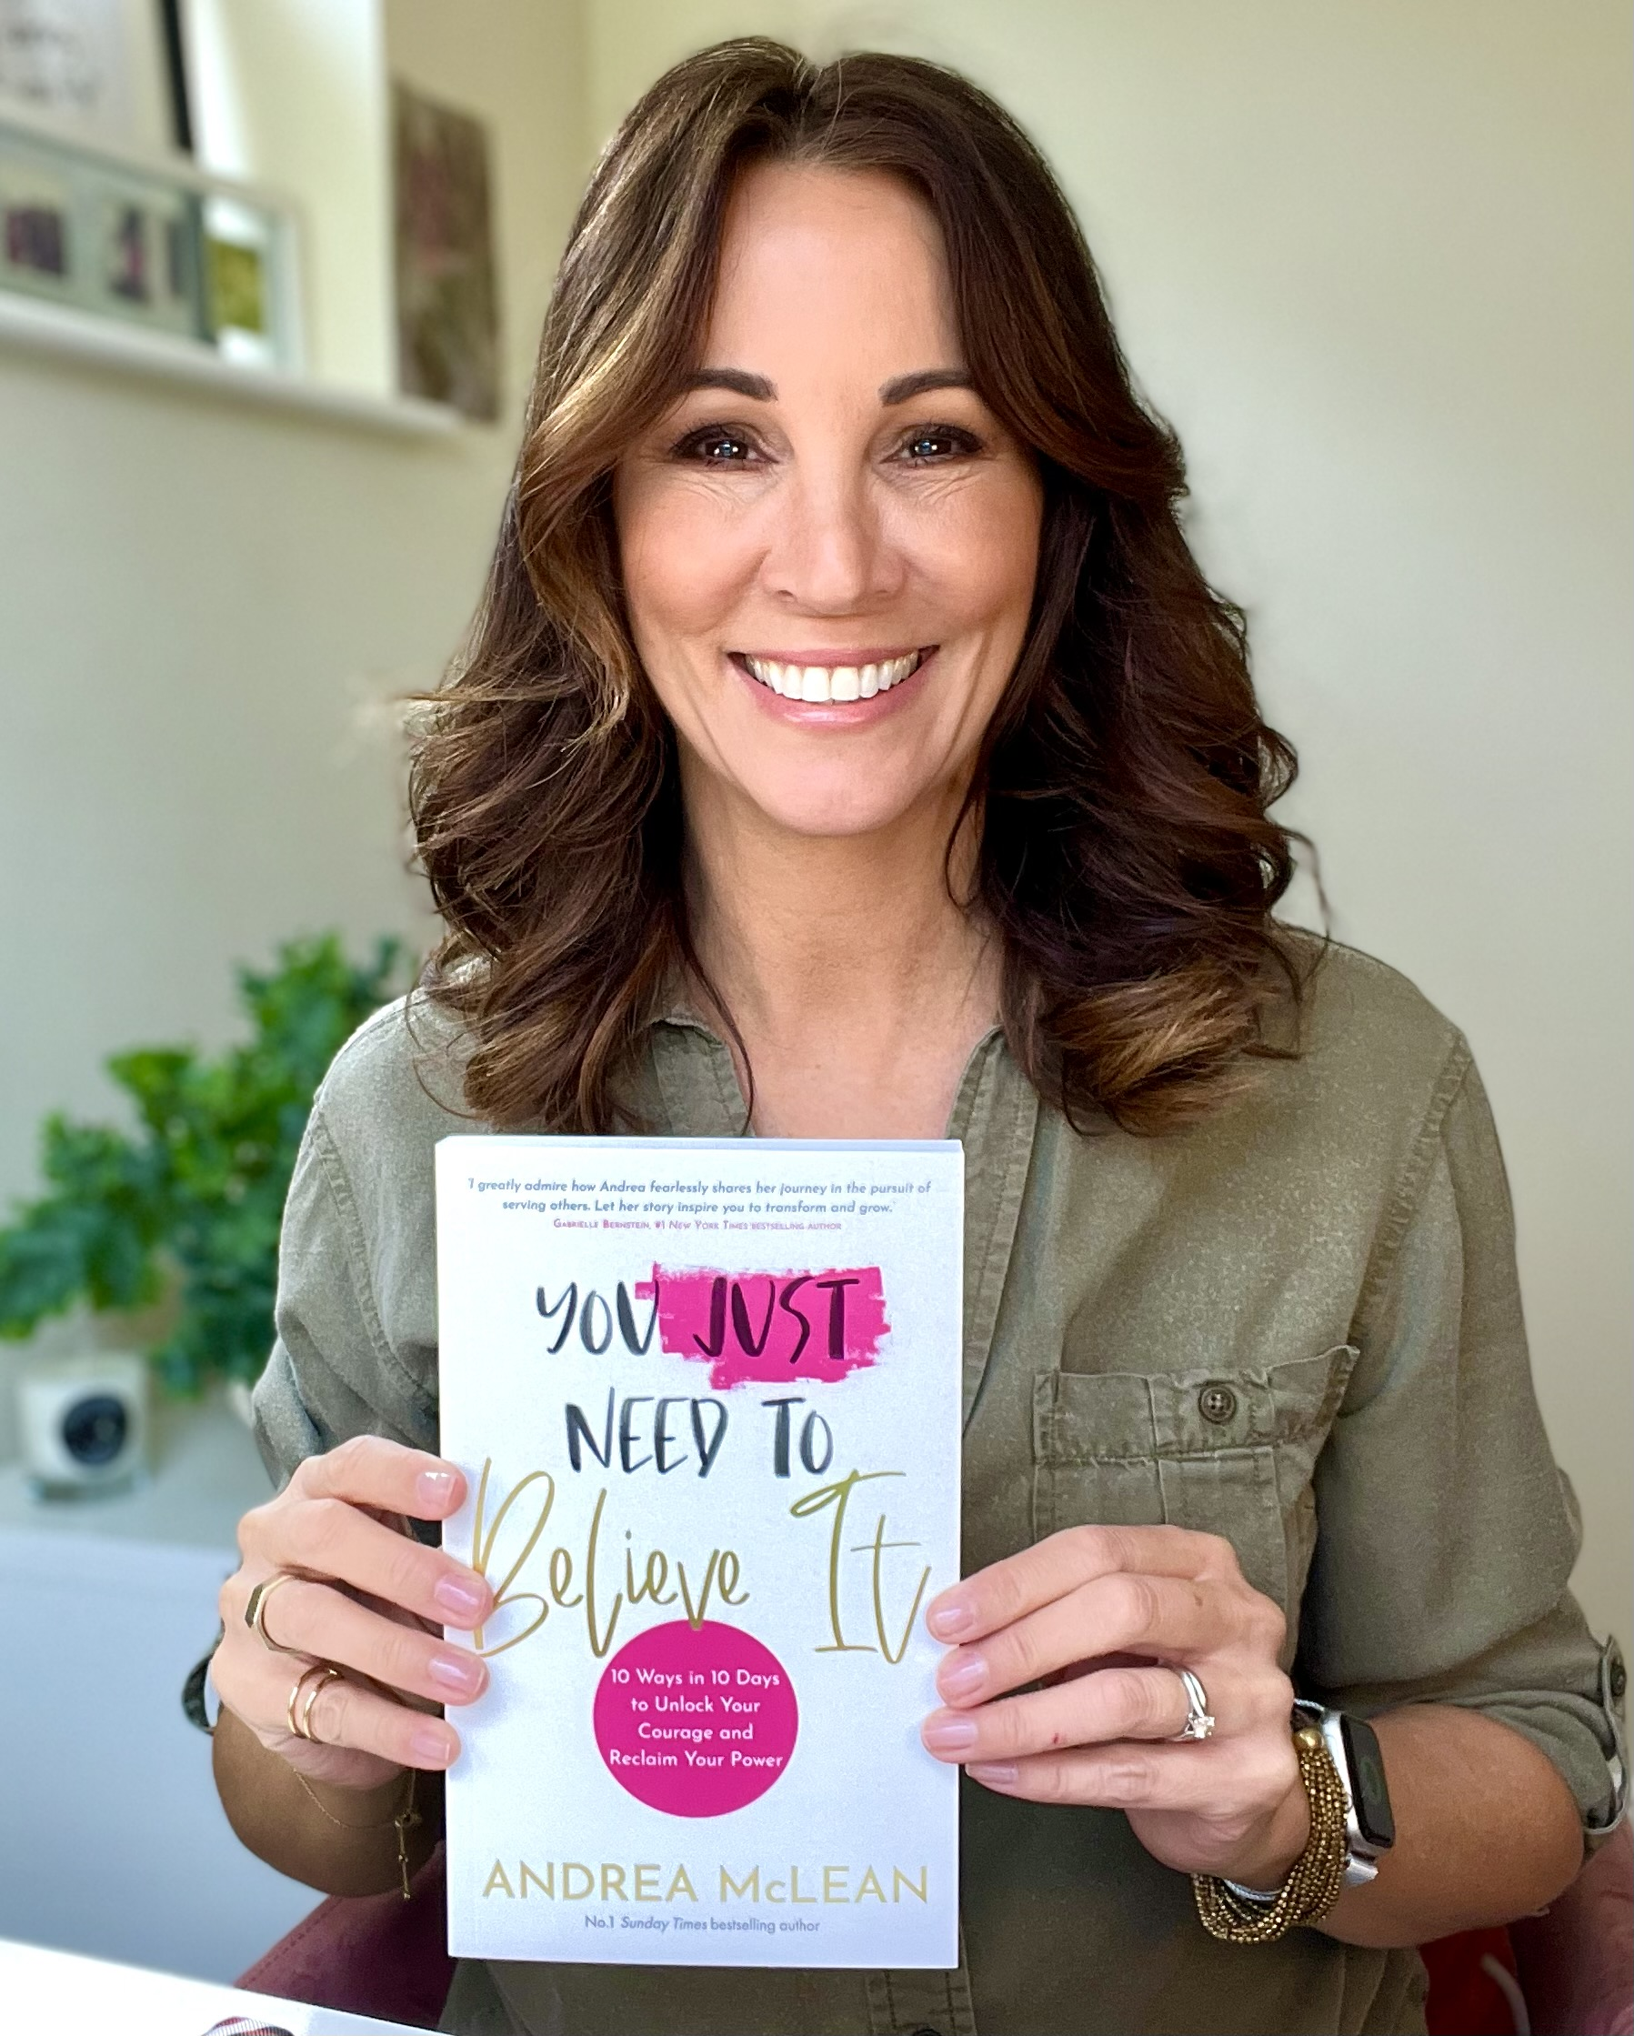
Celebrity Bullying Story
Andrea Mclean
Notes:
INSTRUCTIONS:
Click ‘Andrea’ to watch the video

Slide 3
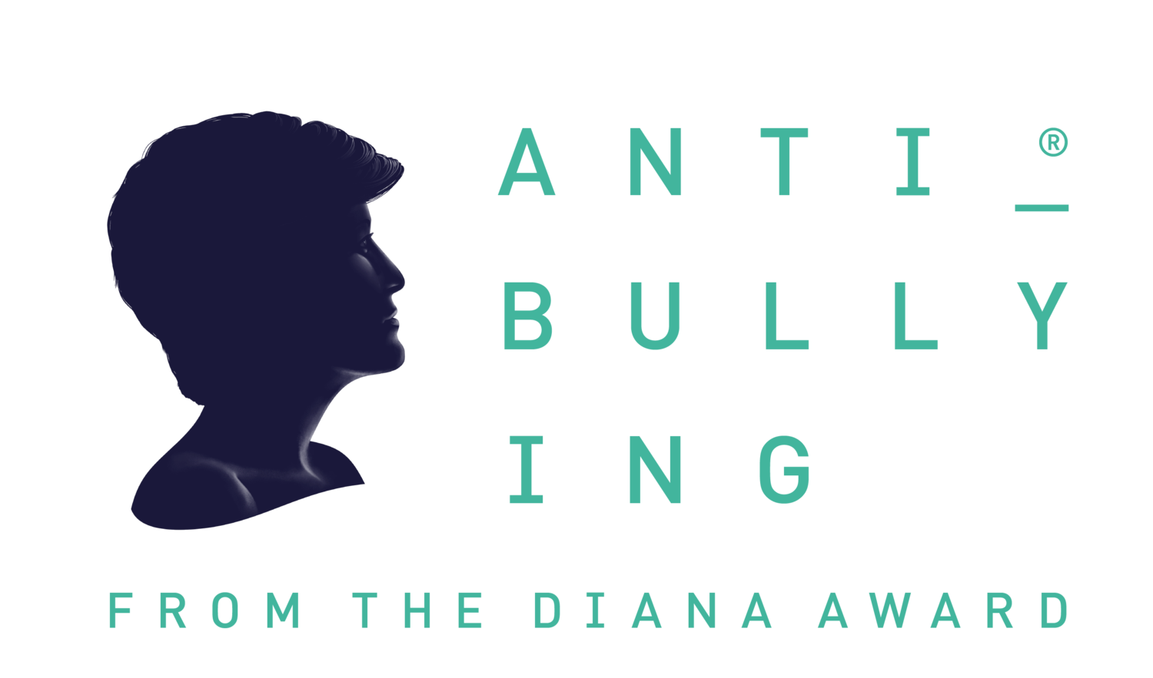
Anti Bullying Week: Hot Topics ‘Falling out with friends’
WATCH: Kieran's Story
Friendships change and evolve all the time, and sometimes it might feel like you’ve ‘outgrown’ a friendship with someone. Or perhaps you and your friend have had a disagreement or aren’t getting along. When friendships dissolve here are some top topics for handling the difficult emotions and interactions that can arise.
Listen to your emotions.
If you’re feeling hurt, unsure, or uncomfortable, don’t brush your feelings aside. Sometimes, it feels easier to ignore the problem, but this could lead to frustration later down the line. Think about what happened? Why did we disagree? Can I put myself in their shoes? What was it about their actions made me upset?
Reflect on the friendship.
If this isn’t the first time you’ve felt hurt by this person, you may want to reflect on your friendship. By reflecting on our relationships with others, we can determine whether they are a positive or negative influence on our lives. For example, if you feel uncomfortable every time you hang out with a friend, or they exhibit bullying behaviour towards you, the friendship could be causing you more harm than good.
Practise your communication skills.
Find an appropriate time and place to chat and share how you feel. Consider your words carefully and give an example to help them understand how their actions made you feel: “I feel upset and insecure when I receive jokes targeting my appearance.”
Find your support network.
If you’re looking for advice, try talking to someone who is completely removed from the disagreement. By speaking to someone who isn’t involved, you’re less likely to get a biased opinion.
Notes:
INSTRUCTIONS:
Click ‘Andrea’ to watch the video

Slide 4
Celebrity Bullying Story
Will Poulter
Notes:
INSTRUCTIONS:
Click ‘will’ to watch the video

Slide 5
Anti Bullying Week: Hot Topics ‘Peer Pressure & Bullying”
Watch: Back me Up!
Some examples of peer pressure can be more obvious than others, such as being pressured to engage in a certain activity, such as drinking, or to go to a certain party. It is important to recognise that other types of peer pressure can be less direct, such as pressure to dress in a particular way or to go along with the crowd to gain approval.
Most people will have to deal with peer pressure at some point in their life. Peer pressure can sometimes have a positive influence, for example you could be encouraged by your peers to be an Upstander against bullying behaviour. However, sometimes it can also have a negative impact. For instance, you might feel pressured into doing something that makes you feel uncomfortable or unsafe or to engage in negative behaviour such as bullying behaviour.
It can be easy to give in to peer pressure for several reasons. For instance, you might feel you need to do what others are doing because you ‘want to be liked’ or ‘to fit in’ (KidsHealth, 2015). You might also give into peer pressure because you ‘fear being teased or physically hurt for not conforming’.
Often, we assume that we can only experience bullying behaviour from people we do not know well. However, if you are feeling pressured by your friends to do something you do not want to do and this is making you feel upset or uncomfortable, this is still not okay.
It is important to remember that you and your friends will not necessarily like the same things, and if they are a true friend, they will respect your decision to not join in. You should never have to experience bullying behaviour or teasing for saying no to something you do not want to do.
Notes:
INSTRUCTIONS:
Click ‘Andrea’ to watch the video

Slide 6
Anti Bullying Week: Hot Topics ‘Peer Pressure & Bullying”
Watch: Back me Up!
Advice / thinking points when experiencing peer pressure:
Establish boundaries
Standing up to your friends and going against the crowd can be intimidating but it is so important to establish clear boundaries with your friends. Honesty and communication are important in any friendship; once you have let your friends know how you feel, they should respect your point of view.
Surround yourself with good friends
If your friends do not respect your boundaries and continue to put pressure on you, then it might be worth reflecting on who you surround yourself with. If you have a passion or a hobby, why not try joining a new extra-curricular club?
Try not to judge
Although you may have different opinions, it is important to still try to not judge your peers who may be pressurising you. Childline emphasises the importance of respect and notes that ‘by respecting their choices, they should respect yours.’
Speak up
Speak with a friend or trusted adult (like a parent/carer or teacher) about what is happening. They will be able to listen and offer support. You could also contact a support service like The Diana Award or Childline; (you can find details at the bottom of this article). If you are ever in immediate danger, call the emergency services (999 in the UK and Ireland).
Notes:
INSTRUCTIONS:
Click ‘Andrea’ to watch the video

