Slide 1
Activity 2: Banter Vs Bullying
2023 Theme:
Ground Rules…
Listen to all opinions!
Agree to stay respectful!
Only one person to talk at once!
No personal comments
Don’t name anyone!
See me if you are worried about bullying
Notes:
INSTRUCTIONS:
Announce that this week is ABW23
Go through ground rules

Slide 2
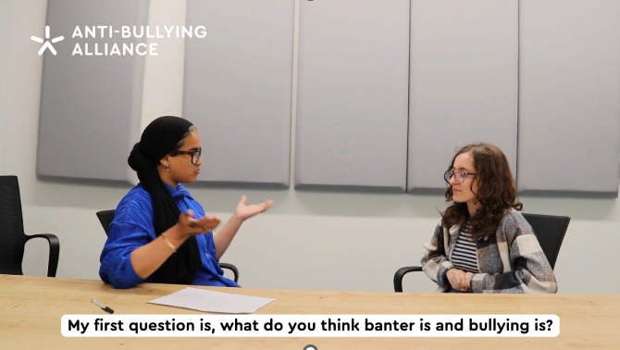
BANTER VS BULLYING
Banter vs Bullying - Whats the Difference?
Notes:
INSTRUCTIONS:
Ask pupils to share their thoughts on the content of the video.
Would you agree with the distinctions made in the video?
Do you think they are fair statements?
How do you think the behaviours are different?

Slide 3
WHAT IS BANTER?
“
Banter is the harmless exchange of social interaction between friends which involves teasing or mocking one another, either on a one-to-one basis or more commonly on a friendship group basis.
EVERYONE MUST BE IN ON THE JOKE!
“
Notes:
INSTRUCTIONS:
Ask students to work in groups to decide on a definition for banter
Compare this to official ABA official affiliate definition

Slide 4
WHAT IS BULLYING?
“
The repetitive, intentional hurting of one person or group by another person or group, where the relationship involves an imbalance of power. Bullying can be physical, verbal or psychological. It can happen face to face or online.
“
Notes:
INSTRUCTIONS:
Ask students to work in groups to decide on a definition for bullying
Compare this to official ABA official affiliate definition.

Slide 5
How banter behaviors may become bullying
Young ABA: Having Boundaries with Banter
When is Banter Bullying?
Notes:
INSTRUCTIONS:
In this part of the session we want to encourage pupils to think about how behaviours that they may think of as banter, could be taken too far and potentially become bullying behaviours.

Slide 6
WHEN IS BANTER ACTUALLY BULLYING?
Think before you speak. Would it be funny if someone said the same thing to you?
Don’t pick on someone's insecurities, that’s a low blow.
Be aware whether someone is clearly not enjoying the ‘banter’. If they’re not, STOP!
Don’t laugh along if you’re not finding it funny.
Saying something is ‘just banter’, doesn’t mean it is.
Notes:
INSTRUCTIONS:
Go through the big 5

Slide 7
IT’S NOT BANTER IF…
You would be upset if someone said it to you.
It’s hurtful.
You’re not friends.
Someone's asked you to stop.
The target isn’t laughing.
It focuses on someone’s insecurities.
Notes:
INSTRUCTIONS:
Go through 1-6

Slide 8
BULLYING OR BANTER?
Notes:
INSTRUCTIONS:
Discuss and feedback the scenario.

Slide 9
BULLYING OR BANTER?
Notes:
INSTRUCTIONS:
Discuss and feedback the scenario.

Slide 10
BULLYING OR BANTER?
Notes:
INSTRUCTIONS:
Discuss and feedback the scenario.

Slide 11
BULLYING OR BANTER?
Notes:
INSTRUCTIONS:
Discuss and feedback the scenario.

Slide 12
BULLYING OR BANTER?
Notes:
INSTRUCTIONS:
Discuss and feedback the scenario.

Slide 13
BULLYING OR BANTER?
Notes:
INSTRUCTIONS:
Discuss and feedback the scenario.

Slide 14
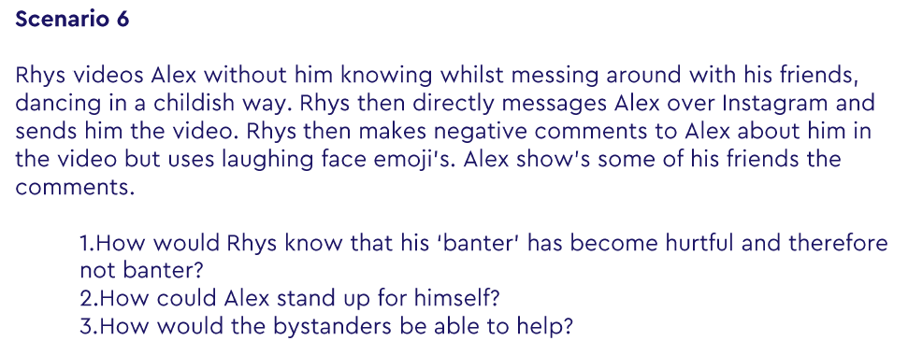
BULLYING OR BANTER?
Notes:
INSTRUCTIONS:
Discuss and feedback the scenario.

