Slide 1
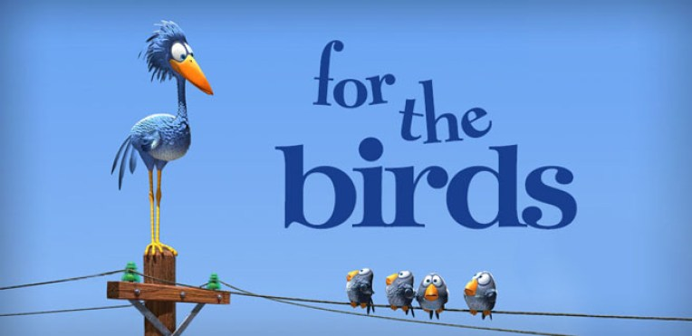
Pixar Animation - For the Birds SHORT MOVIE
Notes:
INSTRUCTIONS:
Show students the short film without telling them this is ABW.
After the short film, ask them what they think the video tells us. Does it have a message? Students will often say that the small birds were unkind to the big bird because he is different. This usually sparks debate. Who are the mean ones? Why are they mean? Are any of the small birds worse than others? Is there a moral to the story? Could we give it a new title?
Why have I showed you this video – It is Anti Bullying Week

Slide 2
ANTI-BULLYING WEEK
13th – 17th November 2023
2023 Theme:
Ground Rules…
Listen to all opinions!
Agree to stay respectful!
Only one person to talk at once!
No personal comments
Don’t name anyone!
See me if you are worried about bullying
Notes:
INSTRUCTIONS:
Announce that this week is ABW23
Go through ground rules

Slide 3
Notes:
INSTRUCTIONS:
Announce that Monday is also World Kindness Day

Slide 4
ABW23 - Official Secondary School film
Notes:
INSTRUCTIONS:
Play ABW23 official film using the highlighted link

Slide 5
WHAT IS BULLYING?
“
The repetitive, intentional hurting of one person or group by another person or group, where the relationship involves an imbalance of power. Bullying can be physical, verbal or psychological. It can happen face to face or online.
“
Notes:
INSTRUCTIONS:
Ask students to work in groups to decide on a definition for bullying
Compare this to official ABA official affiliate definition.

Slide 6
Anti Bullying Alliance: Call for Action!
Too often, we are silent when we see bullying take place, silent about the hurt bullying causes, and silent when we hear bullying dismissed as ‘just banter’.
Together, we can make a difference and take a stand against bullying.
From the playground to Parliament, and from our phones to our homes, let’s make a noise about bullying.
It doesn't have to be this way. Of course, we won’t like everyone, and we don’t always agree, but we can choose respect and unity. This Anti-Bullying Week let’s come together to have discussions about what bullying means to us, how banter can turn into something more hurtful, and what we can do to stop bullying.
Are you prepared to answer the Call?
Notes:
INSTRUCTIONS:
Read the ABA’s call for change.

Slide 7
Anti-Bullying Week 2023: Make a Noise
Notes:
INSTRUCTIONS:
Watch the video using the highlighted link

Slide 8
What’s on? Get Involved!
Art/Media: Comic Strip Competition (Classcharts).
Art: Create Anti Bullying themed graffiti (Classchart).
Photography: Bullying themed projection Competition (in Lesson).
IT/Media: Create a Bullying themed gif (Classcharts).
Music: Influential Music Competition (Classcharts).
English: Poetry & extended writing competition (Classcharts).
Sociology: Banter vs Bullying Debate (lesson).
History: Making Noise Discussion (lesson).
Science: History of Discrimination in Science / Science of Kindness (lesson).
Anti Bullying Ambassador Training
Celebration Event: awards ceremony (invitation only – must enter competition or contribute to ABW in some way)
Notes:
INSTRUCTIONS:
Ask students to work in groups to decide on a definition for bullying
Compare this to official ABA official affiliate definition.

Slide 10
Notes:
INSTRUCTIONS:
Read the kindness facts

Slide 11
Notes:
INSTRUCTIONS:
Read the kindness facts

Slide 12
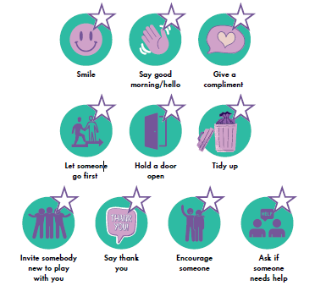
Video 1: Kindness – Lorry Driver
Video 2: Kindness - Veteran
TASK:
Write a two postcards your kindness hero’s (1 friend and 1 member of staff) . Include their name, your name and a short message to say thank you for being so kind. Give your postcards to your student council rep who will post these in the SS post-box.
Notes:
INSTRUCTIONS:
Show both video examples of kindness..
TASK:
Write a post card to two (1 friend and 1 member of staff) of your kindness hero’s. include their name, your name and a short message to say thank you for being so kind. Give the tutor groups postcards to your student council rep who will post these in the SS postbox.

