Slide 1
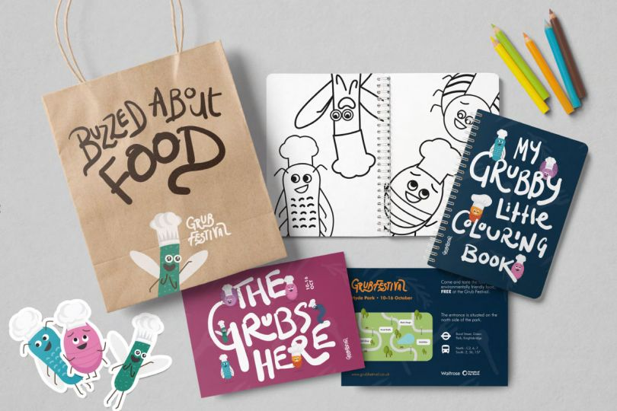
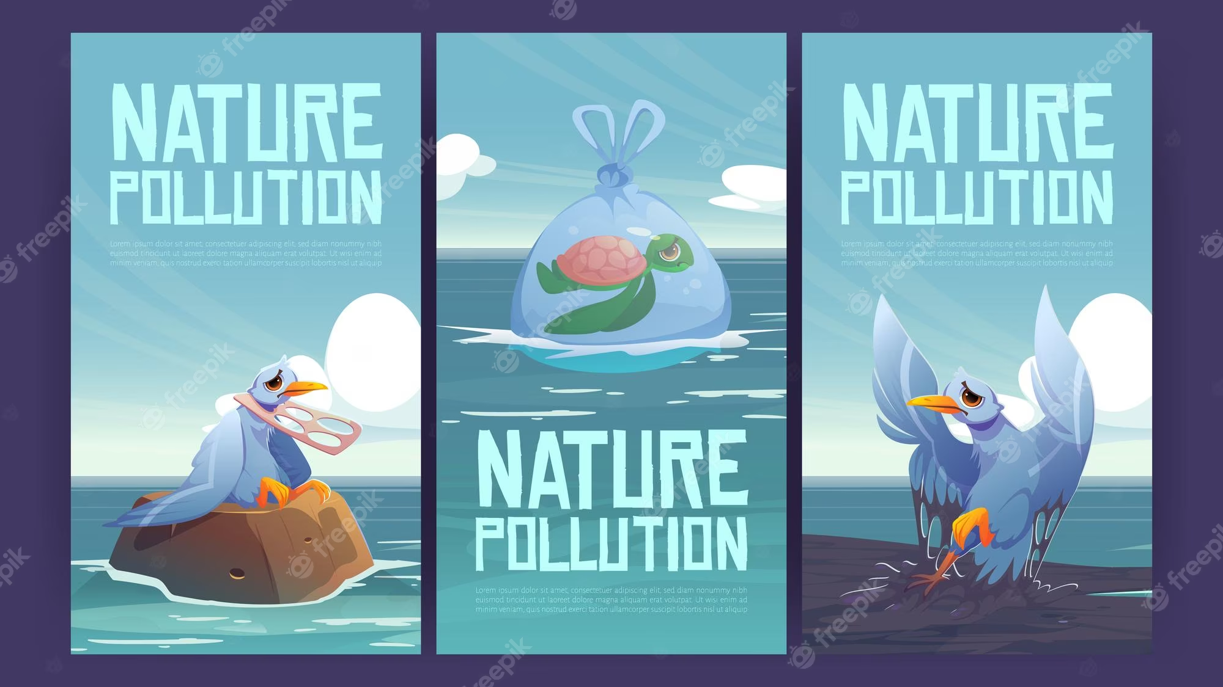
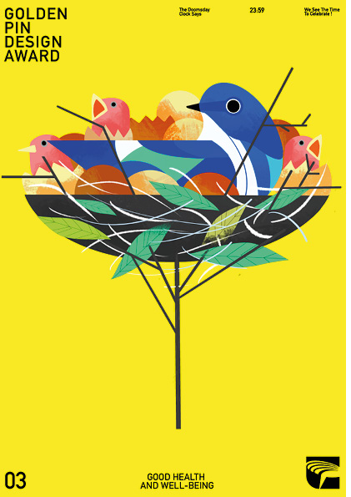
Summer Assignment 2024 Graphics
Famine
Death blood vermin rain
Hail fire
Army drowning on horseback
In your first project of Year 12 you are going to create an awareness campaign. You will need to come prepared in September with ideas for this to discuss and develop in class.
Investigate how Graphic Designers have created campaigns either for advertising or awareness. Find 10 examples (save the images on a Pinterest board).
Choose your own campaign - one from the list on the next slide or something that interests you. Start to investigate this campaign and save 10 images related to it.
Create a mind-map of ideas for images that you could take and use as inspiration in future designs for the campaign – THINK OUTSIDE THE BOX
Campaign Definition; an organised course of action to achieve a goal.

Slide 2
Example Campaigns (you can select an aspect of these campaigns or choose your own):
Health – food, sugar, additives, water, smoking, exercise, mental health etc,
Human issues – women’s rights, LGBT rights, identity politics, social media, racism, class war, social inequality, etc
Ecological - pollution, plastics, air, earth’s resources, ocean/sea/ river life-impact, fast fashion
Slow living – food, growing, making, re-using, cooking etc

Slide 3
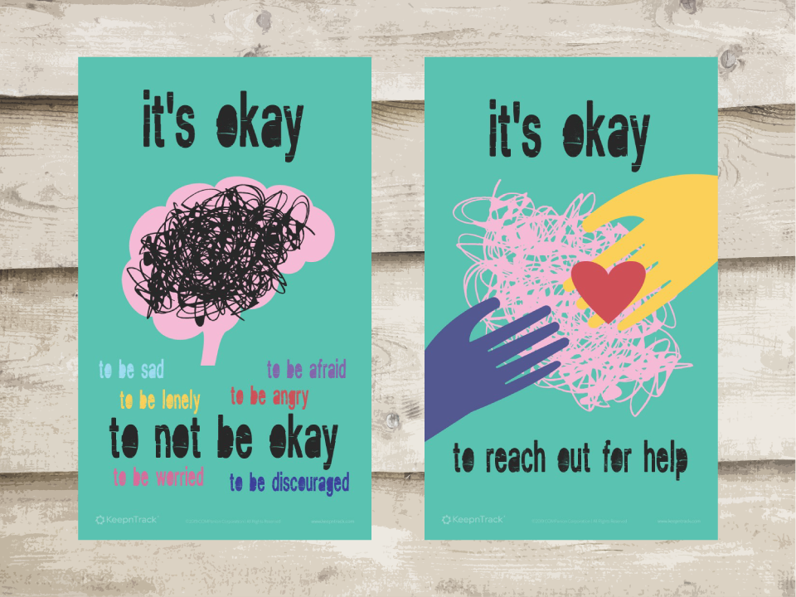
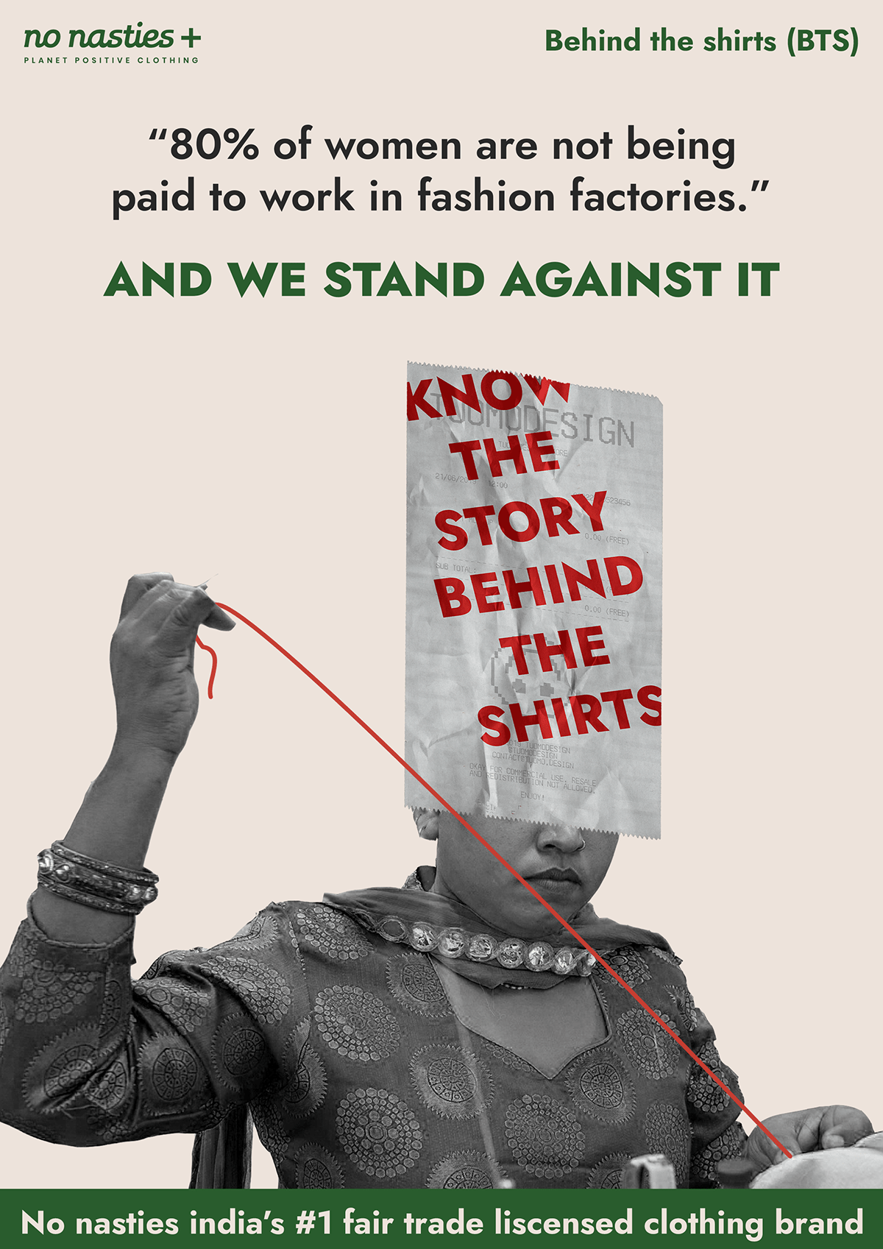
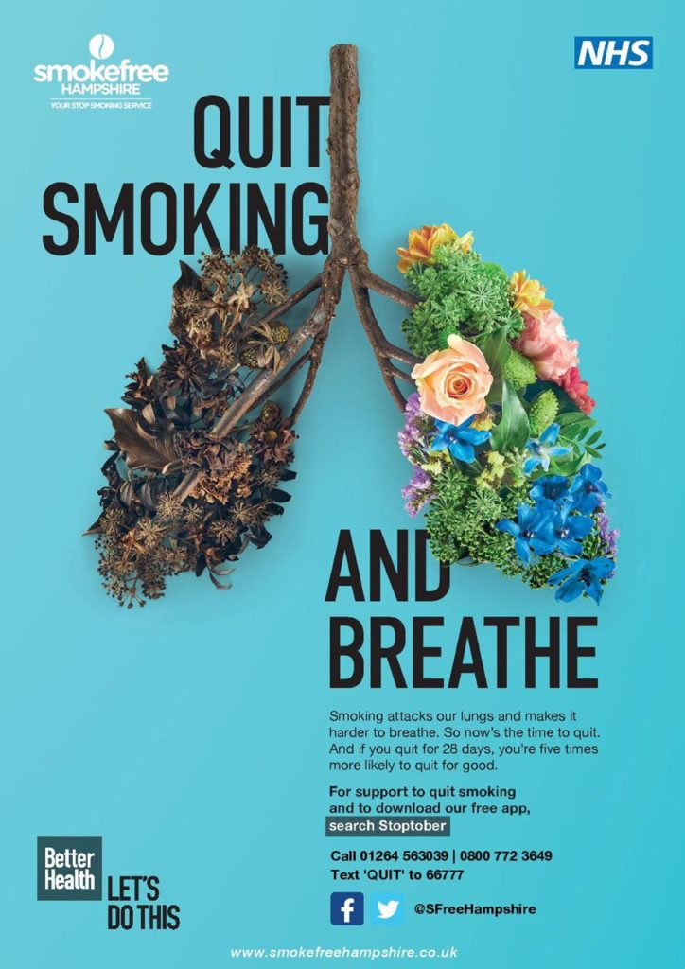
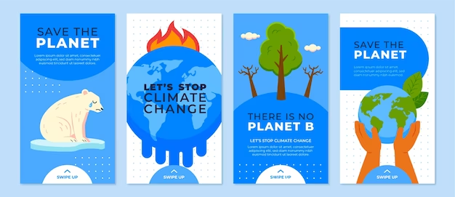
Example Existing Campaigns

Slide 4
Examples of approaches by student designers are on the following slides. Notice how they have translated their design idea across a range of products:

Slide 5
Freke Oppewal, Melbourne Freke Oppewal in Melbourne came up with a clever campaign design for Optical Illusions, an exhibition that promotes the awareness of general eye health amongst a younger audience. We love the optical illusion angle, the chunky typography and monochrome palette.

Slide 6
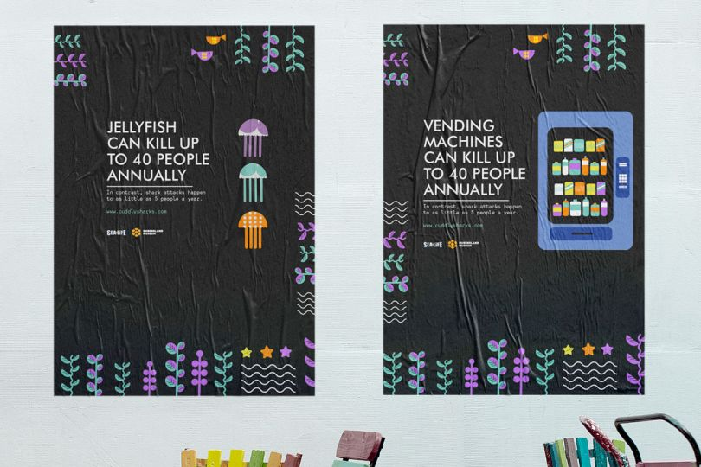
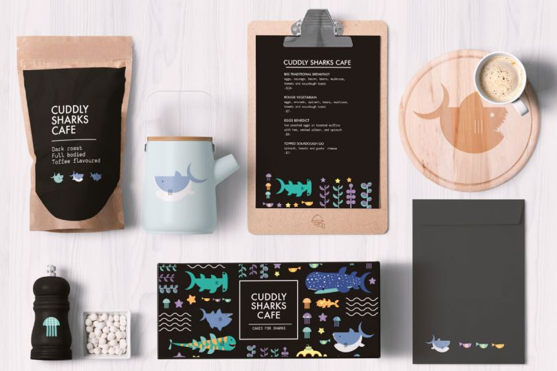
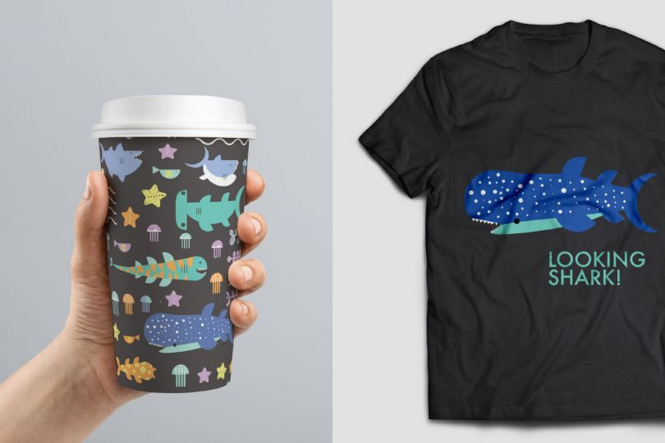
Evena Wong, Brisbane For the Cuddly Sharks Cafe, Evena Wong in Brisbane branded an event aimed at improving the image and reputation of sharks. "Sharks are constantly portrayed as monsters in the media," she explained. "This event aimed to encourage an appreciation for the overlooked charm of sharks." Simple, beautifully illustrated and packing a punch – what's not to love?

Slide 7
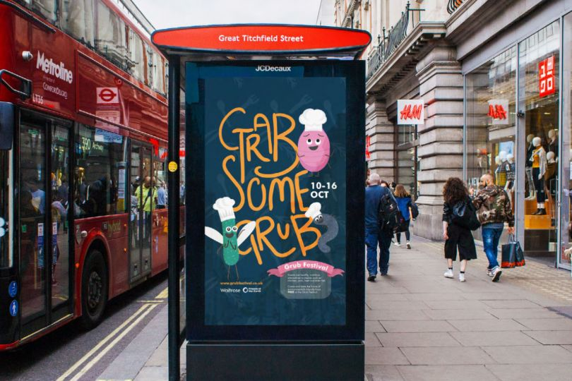
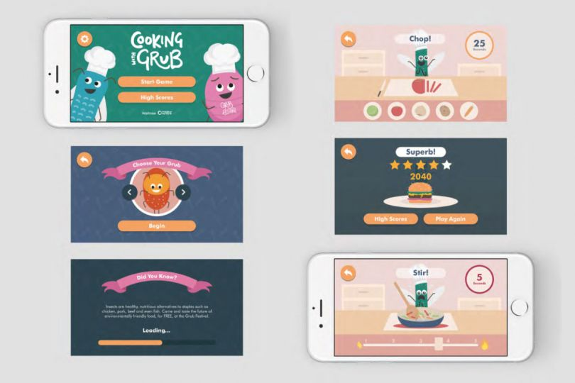
Ray Wong, London Ray Wong at Shillington's campus in London crafted a campaign for the Grub Festival, a festival that asks the question, why shouldn't insects be a considered part of a staple diet today? Ray explains: "The aim was to incite an environmental change by taking the focus away from the livestock industry, and to normalise the consumption of the creepy crawlies, in a fun and exciting way."

